Slide 1
KEYLOGGER IN PYTHON
PRESENTED BY:
SHEIK SOHAIL AHAMED N
INFORMATION TECHNOLOGY
ANJALAI AMMAL MAHALINGAM ENGINEERING COLLEGE

Slide 2
OUTLINE:
• Problem Statement
• Proposed System/Solution
• System Development Approach
• Algorithm & Deployment
• Result (Output Image)
• Conclusion
• Future Scope
• References

Slide 3
PROBLEM STATEMENT
Develop a key logger application in Python that captures keystrokes from the keyboard input of a user and records them into a log file. The key logger should run in the background without the user's explicit knowledge. It should be able to capture keystrokes from any application or window the user interacts with.

Slide 4
PROPOSED SOLUTION
Proposed Solution for Key logger in Python:
Platform Compatibility: Ensure the key logger is compatible with both Windows and Linux operating systems. You may need to use platform-specific libraries or APIs to achieve this.
Keystroke Capturing: Utilize libraries such as pynput to capture keystrokes from the keyboard input. This library allows you to monitor and control input devices such as keyboards and mice.
Logging: Create a log file to store the captured keystrokes. Each keystroke should be accompanied by a timestamp indicating when it occurred. You can use Python's built-in date time module for timestamping.
Running in Background: Implement the key logger to run silently in the background without any visible indication to the user. This may involve techniques like running the script as a daemon or using system-level hooks for intercepting keyboard events.
Stopping the Key logger: Provide functionality to stop the key logger either by a predefined key combination or by terminating the application. This ensures that the user has control over the keylogging process and can stop it if needed.
Ethical and Legal Considerations: Before implementing the key logger, consider the ethical implications and legal consequences associated with monitoring keyboard input without consent. Ensure that the key logger is used responsibly and only for legitimate purposes, such as educational or research purposes, or with explicit consent from authorized individuals.
Testing and Validation: Thoroughly test the key logger to ensure it captures keystrokes accurately and operates as intended on both Windows and Linux platforms. Validate the logging functionality and ensure that the log file contains the necessary information with proper timestamping.
Documentation: Provide clear documentation explaining how to use the key logger, its features, and any potential risks or ethical considerations. Include instructions on how to install, run, and stop the key logger, as well as guidelines for ethical usage.

Slide 5
SYSTEM APPROACH
System Approach for Key logger in Python:
• Input Capture
• Logging
• Background Execution
• Stop Mechanism
• Cross-Platform Compatibility
• Ethical and Legal Considerations
• Testing and Documentation

Slide 6
ALGORITHM AND DEPLOYMENT
Algorithm for Keylogger in Python:
• Import necessary libraries such as pynput for capturing keyboard input and datetime for timestamping.
• Define a function to log keystrokes along with timestamps.
• Create a listener object to monitor keyboard events.
• Define callback functions to handle key press and release events.
• Capture the pressed key, timestamp it, and append it to the log file.
• Implement a mechanism to stop the keylogger (e.g., a specific key combination).
• Ensure cross-platform compatibility.
• Consider ethical and legal implications.
• Test thoroughly.
Deployment:
• Write the keylogger code in a Python script (e.g., keylogger.py).
• Create a deployment package containing the script and any necessary dependencies.
• Optionally, compile the Python script to an executable using tools like pyinstaller for easier deployment.
• Deploy the keylogger on target systems with appropriate permissions and user consent.
• Monitor the log file generated by the keylogger for captured keystrokes.
• Ensure responsible usage and compliance with ethical and legal guidelines.
• Provide documentation and instructions for installation, usage, and ethical considerations

Slide 7
DEPLOYMENT APPROACH
Local Deployment:
Run the Python script on the local machine where you want to capture keystrokes.
Ensure that the script runs in the background (e.g., minimize the console window).
The key logger will save all keystrokes to the specified log file.
Executable Creation:
Convert the Python script into an executable (e.g., using tools like py installer or cx_Freeze).
Distribute the executable to target machines.
Users can run the executable discreetly to start the key logger.
Ethical Considerations:
Always use key loggers responsibly and legally.
Obtain proper consent before deploying a key logger.
Educate users about the purpose and scope of monitoring.

Slide 8
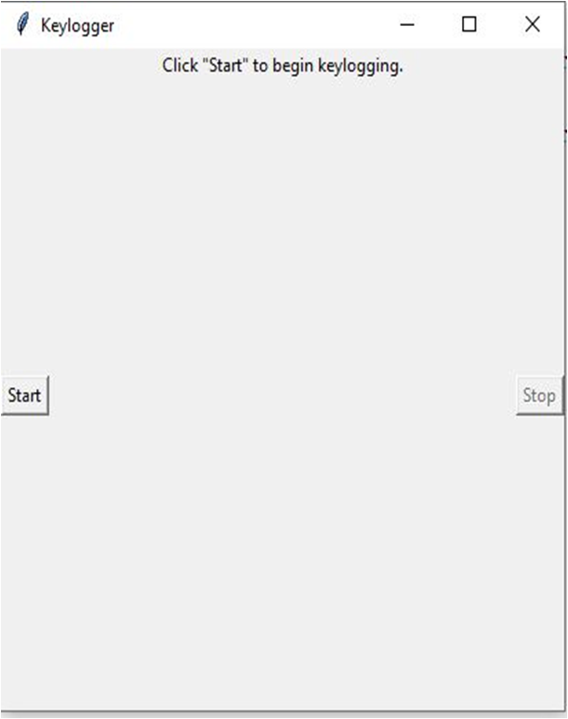
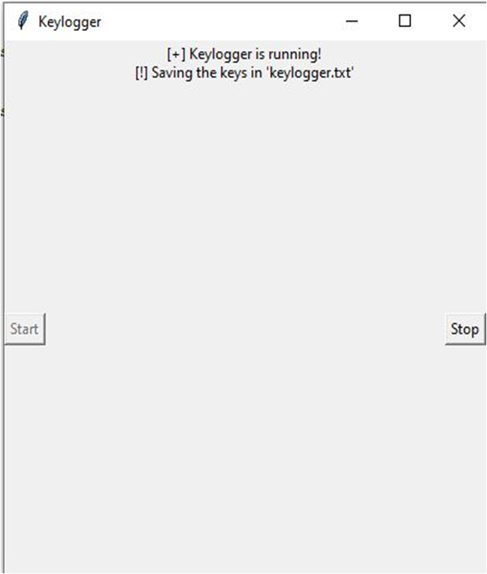
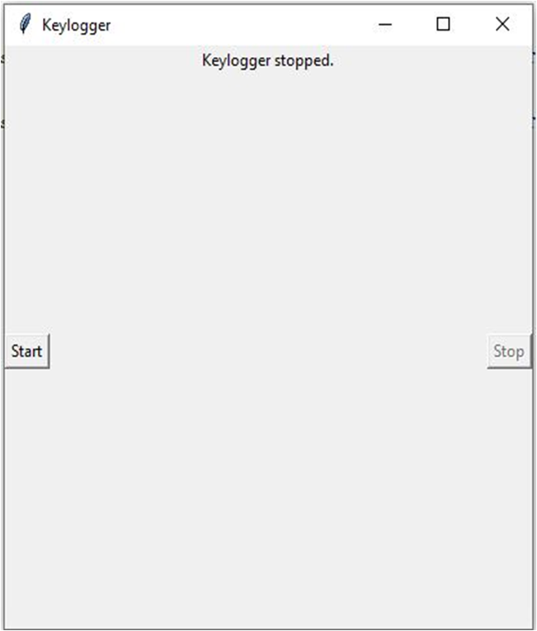
RESULTS
The key logger runs and saves all key Logs to “c:\output.txt”.
TO START KEY LOGGER
KEY LOGGER RUNNING
KEY LOGGER TERMINATED

Slide 9
CONCLUSION
our Python key logger project aims to capture keystrokes on a computer system. It can be used for security, monitoring, research, or educational purposes.
In conclusion, the key logger project serves as a valuable learning experience, providing insights into cybersecurity, ethical considerations, and the responsible development of monitoring tools.By approaching key logger development with a commitment to ethics and integrity,
we can harness the potential of such tools while safe guarding privacy and respecting individual rights.

Slide 10
FUTURE SCOPE
Security and Troubleshooting:
Key loggers can continue to play a crucial role in troubleshooting technical problems with computers and business networks. They help identify issues related to keyboard input, system behavior, and software conflicts. Key loggers can be integrated into security systems to detect unauthorized access attempts or suspicious activities. By monitoring keystrokes, they can raise alerts when unusual patterns are detected.
User Monitoring and Productivity:
Organizations can use key loggers to monitor employee productivity, track work-related activities, and ensure compliance with company policies.
Key loggers can help parents keep an eye on their children’s online activities, ensuring their safety and responsible internet usage.
Cross-Platform Key loggers:
Extend key loggers to work on multiple operating systems (Windows, Linux, macOS, Android, iOS).
Cloud Integration: Store logs securely in the cloud, allowing remote access and analysis.
Machine Learning: Implement machine learning algorithms to detect anomalies or predict user behavior based on keystrokes.

Slide 11
REFERENCES
GeeksforGeeks provides a detailed tutorial on creating a keylogger using Python. It covers capturing keystrokes, saving logs, and handling security considerations.
Design a Key logger in Python – GeeksforGeeks.
Wikipedia’s article on keystroke logging provides an overview of keyloggers, their history, and various applications.
Keystroke Logging – Wikipedia

Slide 12
Thank You

